Slide 1

The Syntex
Sales Force Story
SSAA Meeting
February 1, 2025
Jack Tuttle

Slide 2

Agenda
The Fuel
The Field Sales Force
Pharmaceutical Industry
Challenges
The Roche Acquisition
Life After Syntex

Slide 3

The Fuel
Current Products
New Products
Compounds in Development
Co-Promotion
Joint Ventures
.

Slide 4
Sales Force Organization
  Regions
    Regional Manager
      Regional Trainer
      Government Accounts Manager
      Administrative Assistant
    Districts
      District Manager
        Representatives
  Specialty Groups
    Hospital Group- Teaching, Kaisers, Military
    Dermatology Representatives
    Marketing Manager Advisers
    Dedicated Managed Care Group

Slide 5
The Field
  Reps Represent the Company
  Physicians Look to Reps for Information
  Company + Products + Rep = Physician’s Imagine
.

Slide 6

Syntex was great to work with. Nancy was my representative and she anticipated my needs and worked diligently to provide great information.
A satisfied physician

Slide 7
The Industry
  Product Launches
  Sales Force Expansions
  Specialty Drugs and Targeted Therapies
  Managed Care Influence
  Growth of PBMs
  Costly Drugs
  Direct to Consumer Advertising
  Drugs Available Over The Counter

Slide 8
The Challenges
  Building a Strong Culture
  Sales Force Expansion
  Introduction of DDD
  New Competition
  Managed Care Formularies
  Consent Decree
  Patent Expiration
  Realigning the Sales Force
.

Slide 9
Realigning the Sales Force
Red Team
Blue Team
Purple Team- Hospital/Military
Physicians
  GP, FP, IM, Rheum's, Orthopedic Surgeons
Products
  Naprosyn
  Anaprox
  Nasalide
  Arane
  Lidex, Synalar
  Toradol
Physicians
  GP, FP, IM, OBGYNs, Cardiologists
Products
  Naprosyn
  Anaprox
  Cardene
  Ticlid
  Toradol
  Norinyl
  Femstat
  Evex
All Physicians
Residency Programs
  Rheumatology
  Dermatology- Derm Force
  OBGYN
  Orthopedics

Slide 10

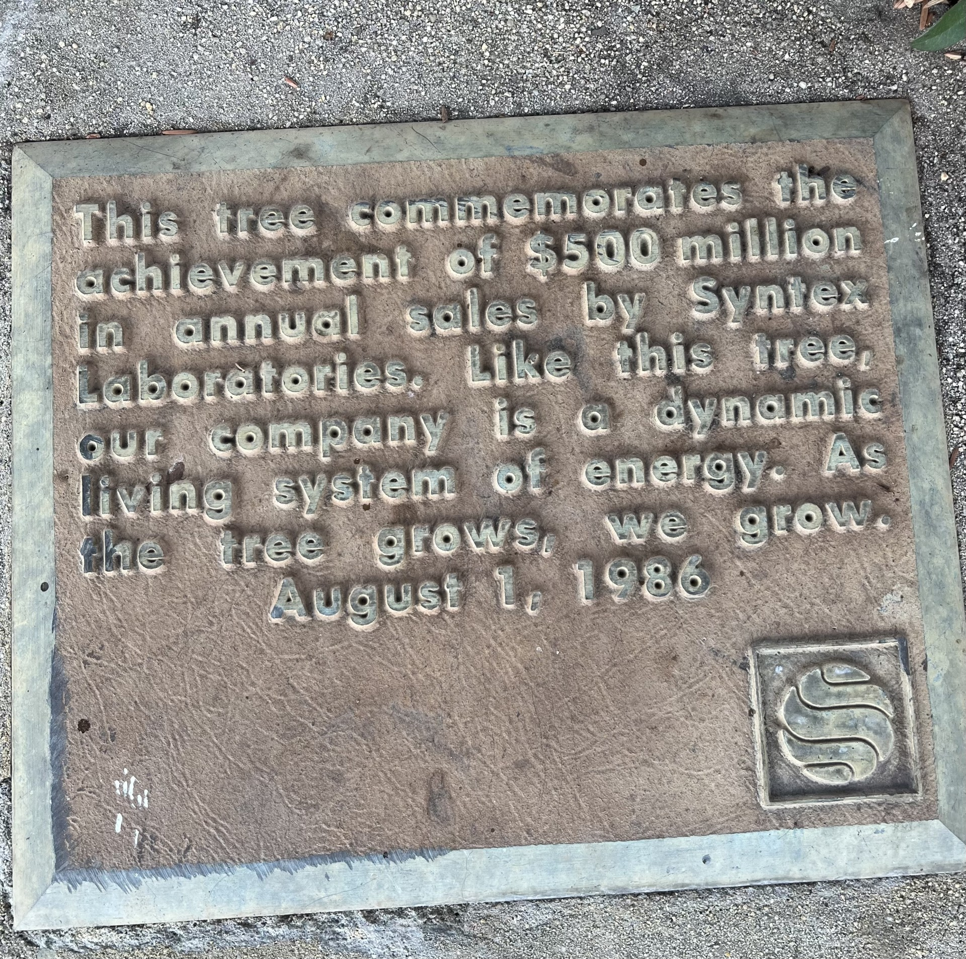
Achievements
1986
This Photo by Unknown Author is licensed under CC BY-SA

Slide 11


Achievements
1991-92
This Photo by Unknown Author is licensed under CC BY-SA

Slide 12
Opportunities & Growth
  Personal & Professional Growth
  Valued Employee
  Recognition

Slide 13


The $5.3 Billion Acquisition 1994

Slide 14
Why did Roche acquire Syntex?

Slide 15
Selective Products
New
Compounds
Tax
Benefit
Manufacturing

Slide 16
1994: 4th Largest Global Pharma Company
1. Merck
2. GlaxoSmithKline
3. Pfizer
4. Hoffman-La Roche
5. AstraZeneca
6. Eli Lilly
7. Bristol-Myers Squibb
8. Sanofi
9. Novartis
10. Johnson & Johnson

Slide 17
2024: 3rd Largest Global Pharma Company
1. Johnson & Johnson
2. Pfizer
3. Hoffman La Roche
4. Novartis
5. Merck
6. Sanofi
7. AstraZeneca
8. GlaxoSmithKline
9. Abbvie (Humira)
10. Bristol-Myers Squibb

Slide 18
Life after Syntex

Slide 19

Life After Syntex
  Many remained in the industry
  Some transitioned to Roche
  Others chose new ventures
.
And many said “Syntex was the best company!”

Slide 20
My Story
  Worked at 2 start-ups
  IMS
    New Business Development
    Supplier Management
    Sales Director – West Region
  Currently Real Estate Agent
      Residential and Investment
.

Slide 21
Thank You

